Slide 2
6D CMP Helix

Slide 3
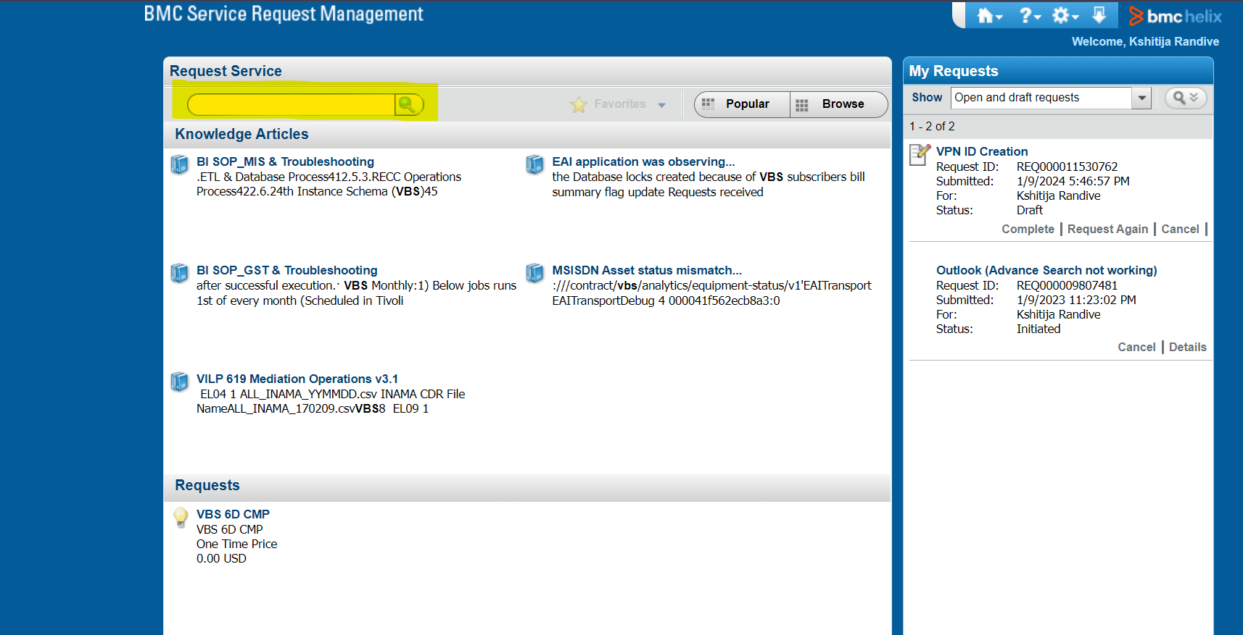
Search VBS 6d CMP to get the form for raising the ticket for 6D CMP team

Slide 4
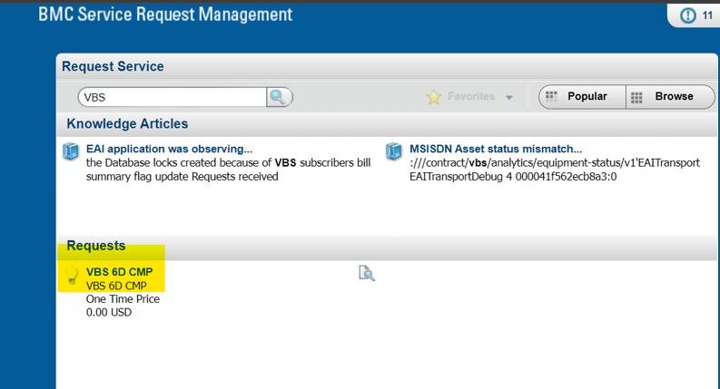

Slide 5
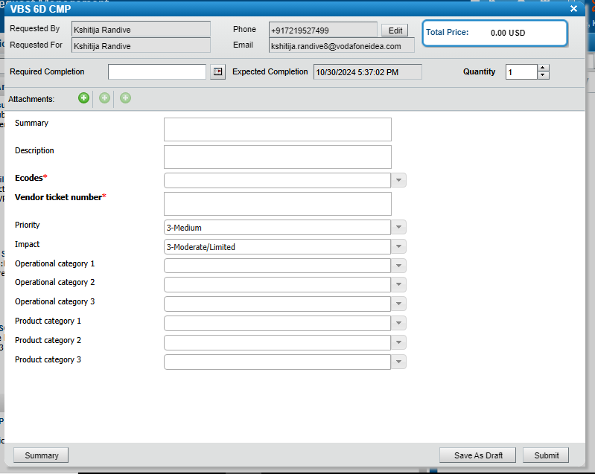
Now the form will be open and you have to fill the details to raise the Ticket

Slide 6
To raise the Ticket follow the below steps
For Sending mail format will be the same which we are following only in TO- don’t mention IT ID mail ID
Summary- Subject Link of the Mail
Description- The main body
Ecode- Reported enterprise e-code.
Vendor Ticket number- HPSM ticket ID
Priority: Category are provided in the next slide
Impact: Category are provided in the next slide
Operational Category 1- Application
Operational Category 2- Application
Operational Category 3- VBS
Product Category 1- 6D CMP

Slide 7
IOT Service Impacted Category
Category | Service Impacting | S3/S4
APN Service impact | Yes | S3
Billing Count mismatch | No | S4
Billing Service Impacting | Yes | S3
Camel flag mismatch | Yes | S3
Customer Query | No | S4
Customer Requirement | No | S4
Duplicate | No | S4
GPRS Service barred | Yes | S3
HLR View mismatch | Yes | S3
Migration Data Mismatch | Yes | S3
No action required | No | S4
Order Delay | Yes | S3
Order failed | Yes | S3
Report | No | S4
SMS barring | Yes | S3
Service Request | No | S4
User Understanding Issue | No | S4
Data/SMS Not working | Yes | S3
Wrongly assigned | No | S4
Number Whitelisting | Yes | S3

Slide 8
Product Category 2 and Product Category 3 -below refer below table:
Category | Subcategory
1. CMP portal related | Portal not working
 | Profile/Features not visible
 | Portal Features not working
 | Other CMP portal related
2. Activation/Deactivation | Suspension/Reactivation
 | Delay in provisioning order
3. Enquiry | Billing And Payment
 | CMP
 | Other
4. Whitelisting issue | SMS whitelisting
 | Voice whitelisting
 | Data whitelisting
Product category are the main category to raise the ticket to the 6d CMP team depending on the issue of the customer.

Slide 9
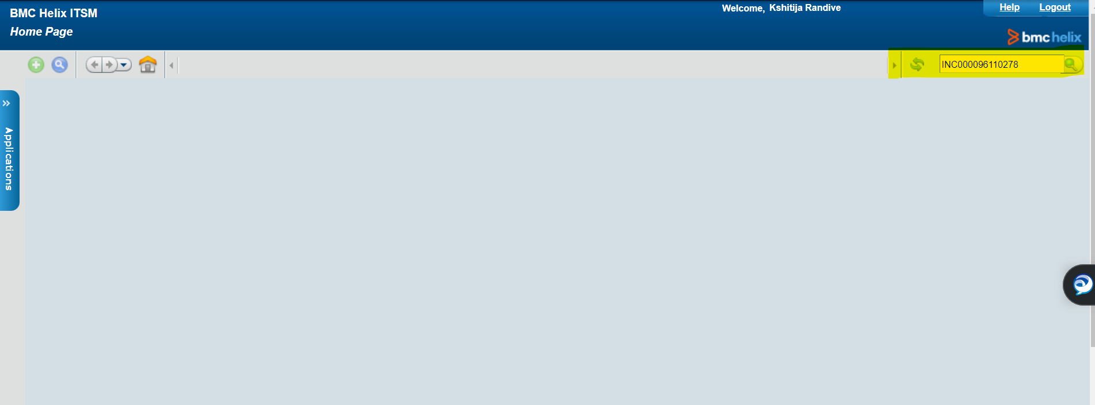
How to search the INC Ticket number in Helix
Go to the IT Home page- In search bar just search the REQ ID or the INC ID

Slide 10
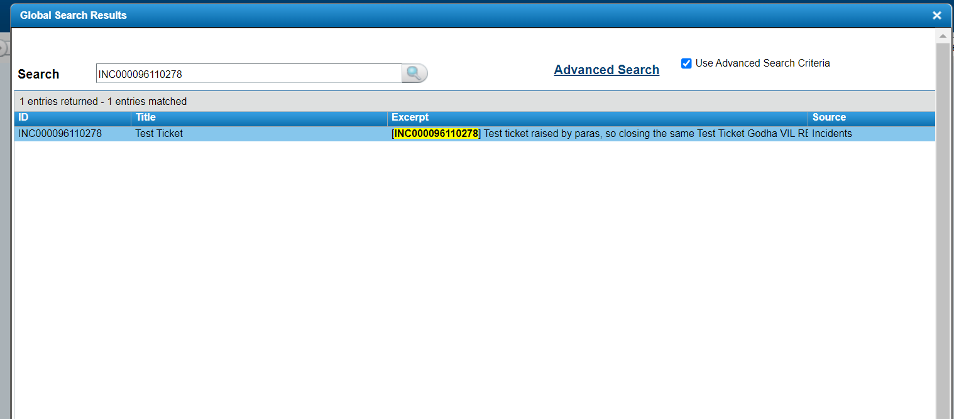
How to search the INC Ticket number in Helix
After searching you will get the below window- Open the INC Ticket

Slide 11
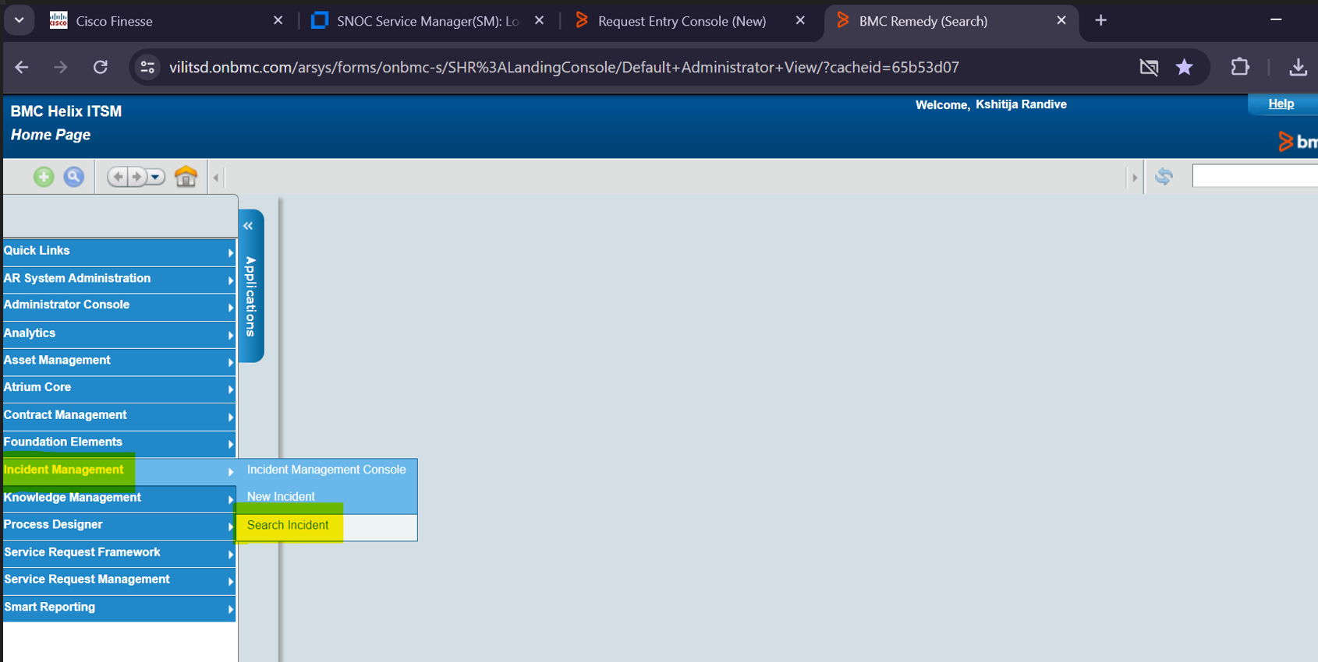
How to download the dump?
Go to the IT Home page- In Left hand side menu go to Incident Management- Search Incident

Slide 12
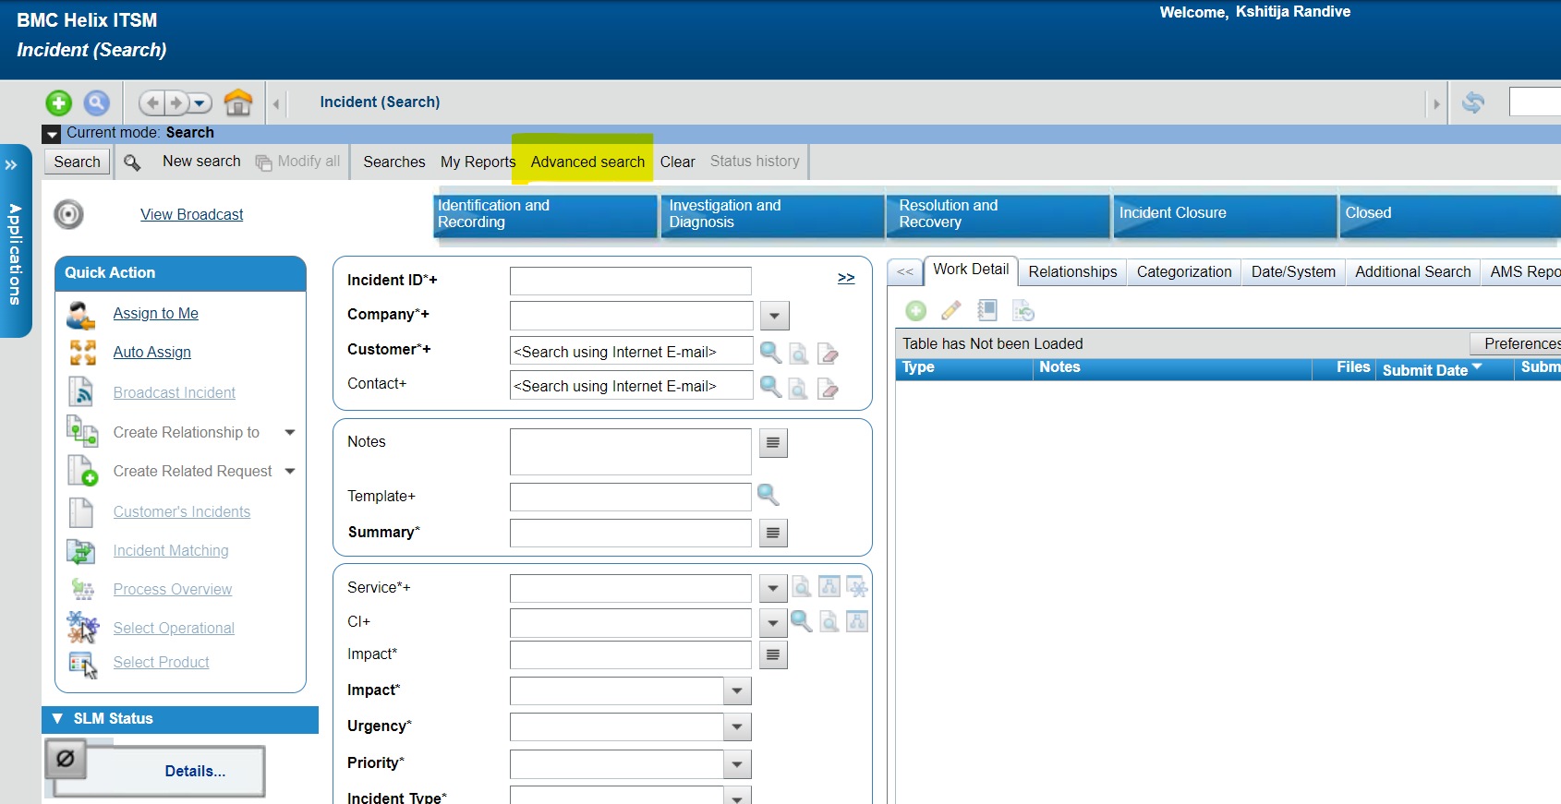
How to download the dump?
Go to the Advanced Search option
How to download the dump?

Slide 13
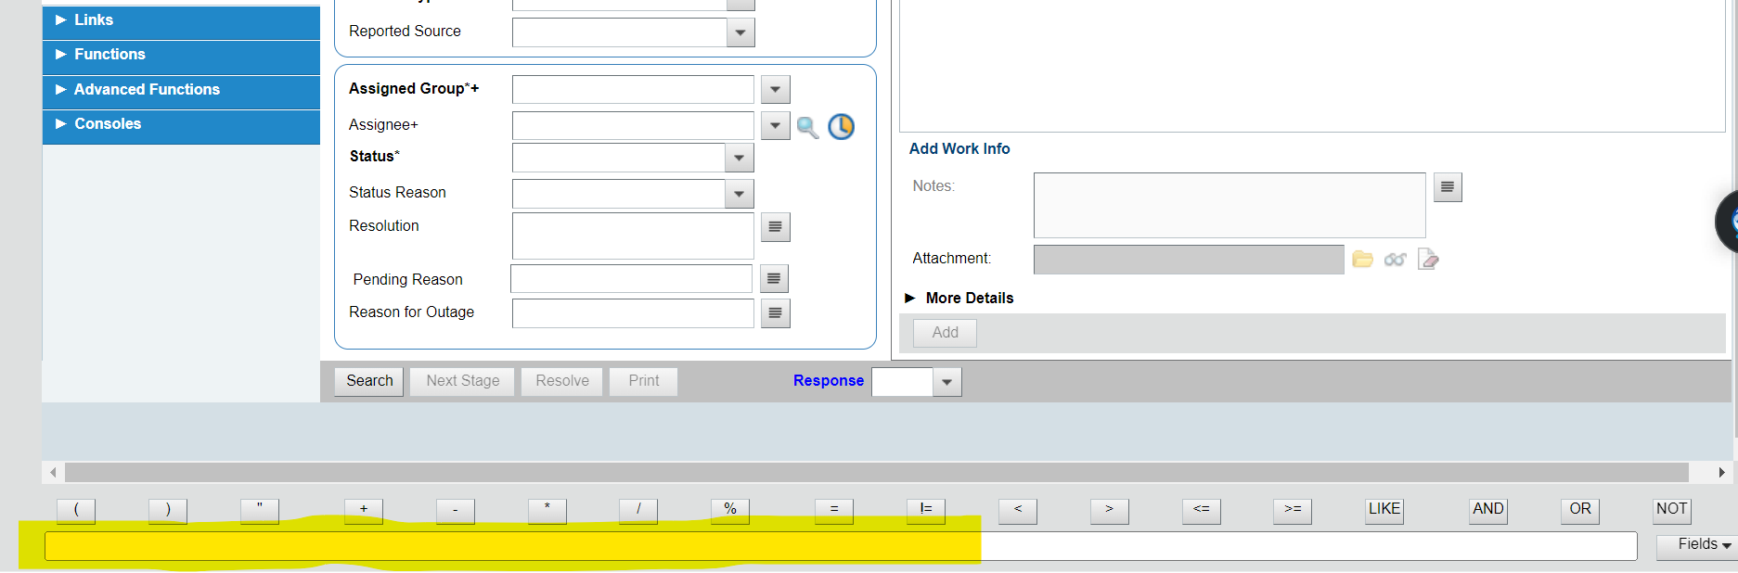
How to download the dump?
At the bottom you will get one bland field- you have put one command over there-
'Assigned Group*+' = "6D CMP Operations Support" AND 'Reported Date+' > "5/20/2024 12:00:00 AM" AND 'Vendor Ticket Number' != $NULL$

Slide 14
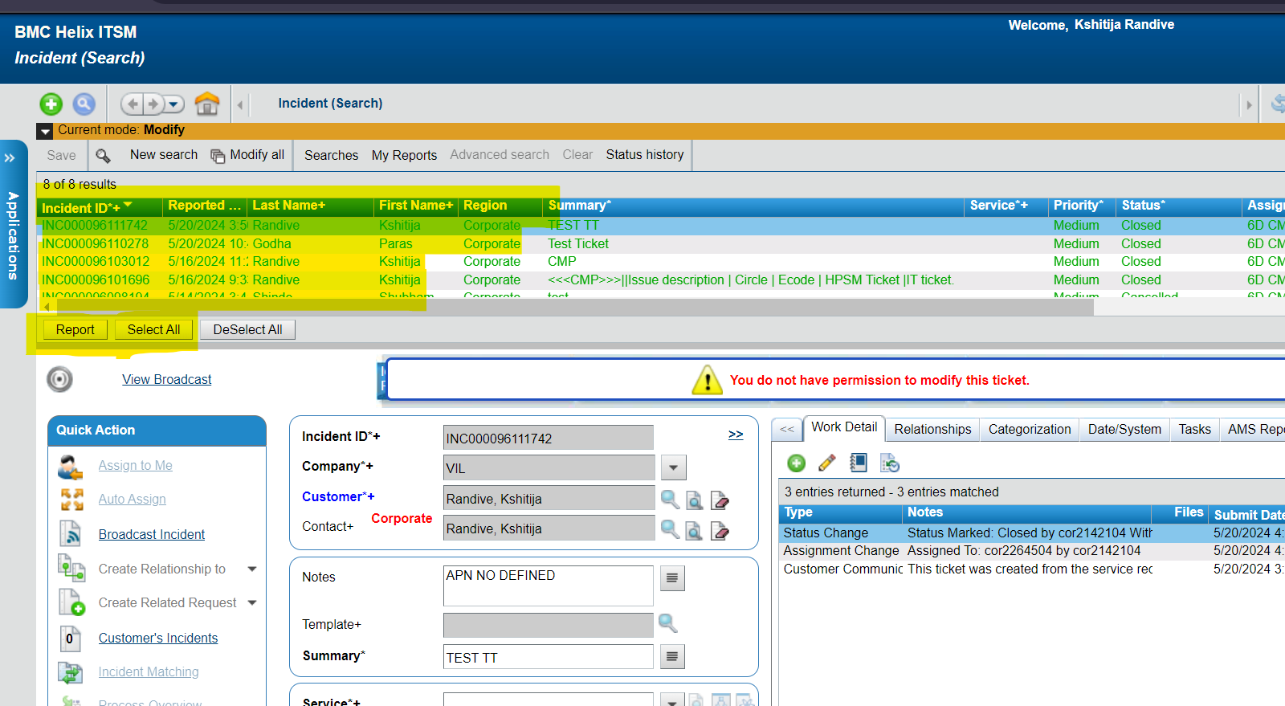
How to download the dump?
Upside the page you will get the above report option
You need to Select All- Report

Slide 15
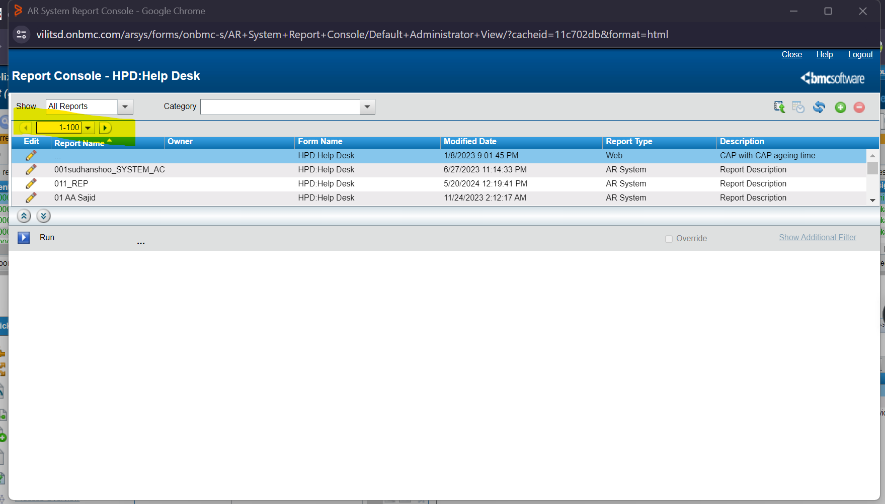
How to download the dump?
Then in the report section, you need t o select the required format of the report

Slide 16
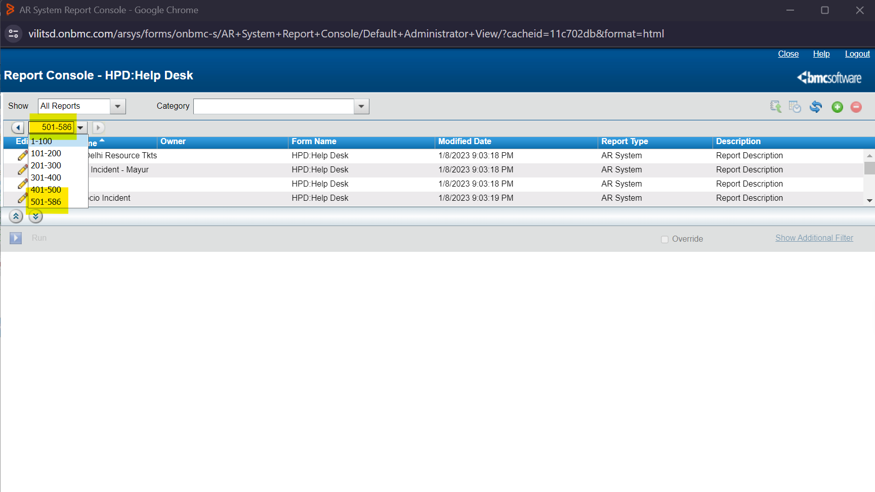
How to download the dump?
For IOT Required format series is 501-586- select the number series

Slide 17
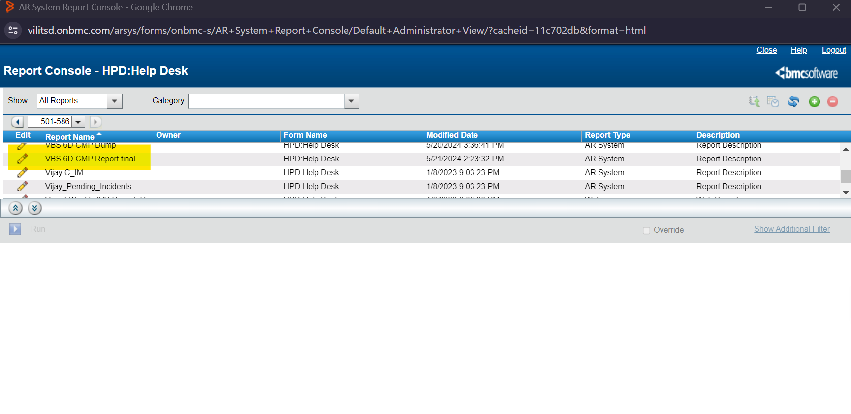
How to download the dump?
Select the Format VBS 6d CMP Report final

Slide 18
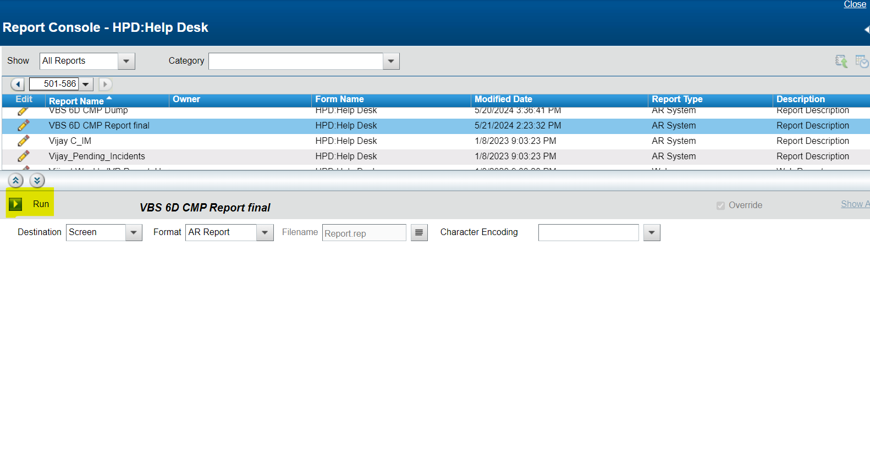
How to download the dump?
Click on Run button

Slide 19
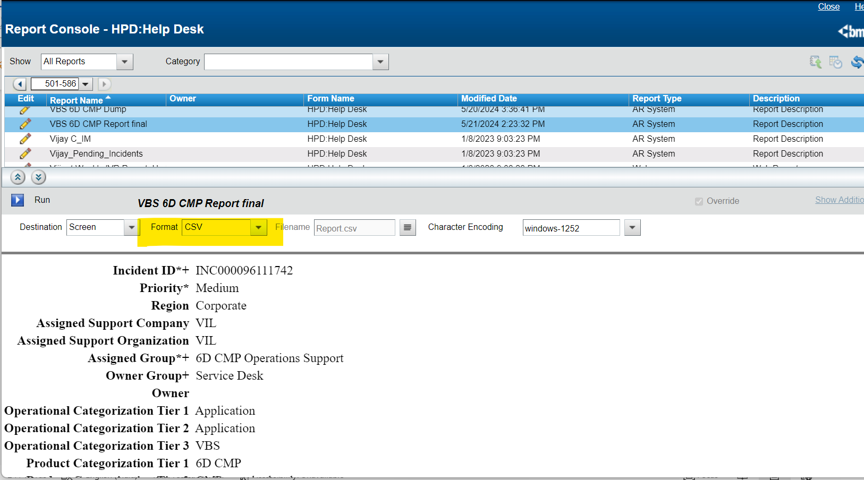
How to download the dump?
Click on Format- CSV- then Click – Run
The Dump will downloaded

Slide 20
Thank you !

